Slide 1
Secure and Efficient Medical Image Encryption using Deep Learning Methods
Joseph B Choi, Karolina Naranjo-Velasco
November 4, 2022

Slide 2
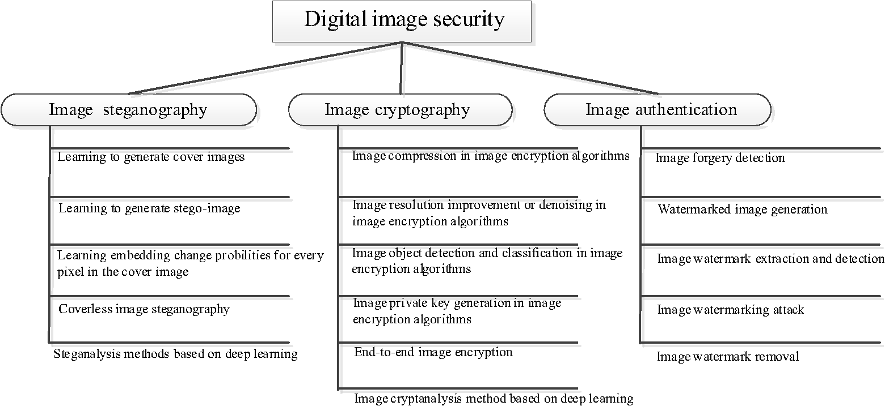
Review on Secure and Efficient Encryption and DL
Bao, Z., & Xue, R. (2022). Survey on deep learning applications in digital image security. Optical Engineering, 60(12).
Notes:
Our survey will be the subtopic of mentioned survey.
Especially, “Digital Image security” -> “Image cryptography” -> “End-to-end image encryption” -> in medical field.

Slide 3
Article | Year & Publisher | Approach/Techniques
Survey on deep learning applications in digital image security. | 2021 Optical Engineering | steganography, image cryptography, and image authentication.
A New V-Net Convolutional Neural Network Based on Four-Dimensional Hyperchaotic System for Medical Image Encryption | 2022 Security and Communication Networks | CNN (V-Net)
Privacy-Preserving Deep Learning With Learnable Image Encryption on Medical Images | 2022 IEEE | GradCAM
An improved image processing based on deep learning backpropagation technique, | 2022 Complexity | backpropagation, cycle-gan
Image scrambling adversarial autoencoder based on the asymmetric encryption | 2021 Multimedia Tools and Applications | adversarial autoencoder

Slide 4
Article | Year & Publisher | Approach/Techniques
Invertible encryption network for optical image cryptosystem | 2022 Optics and Lasers in Engineering | Invertible Neural Network
DeepEDN: A deep learning-based image encryption and decryption network for internet of medical things | 2022 IEEE Internet of things Journal | Cycle-GAN
Research on the avalanche effect of image encryption based on the Cycle-GAN | 2021 Applied Optics | Cycle-GAN
Cellular Neural Network-Based Medical Image Encryption | 2020 SN Computer Science | hyperchaotic cellular neural network (CNN) & DNA
FEDResNet: a flexible image encryption and decryption scheme based on end-to-end image diffusion with dilated ResNet | 2022 Applied Optics | diffusion & CNN (ResNet)
Security of Medical Images for Telemedicine: a Systematic Review | 2022 Multimed Tools Appl | Cryptography, steganography, watermarking
A review on deep learning in medical image analysis | 2022 International Journal of Multimedia Information Retrieval | ResNet
DeepKeyGen: A Deep Learning-Based Stream Cipher Generator for Medical Image Encryption and Decryption | 2022 IEEE Transactions on Neural Networks and Learning Systems | Generative adversarial network (GAN)

